Slide 1

How to Work in Cloud Native Security
Demystifying the security role
Justin Cormack

Slide 2
Who am I?
Justin Cormack
Senior Engineer at Docker since 2015 Cambridge, UK
@justincormack

Slide 3


Slide 4
How I got into security by mistake

Slide 5
My first security work
working as a sysadmin in a university back in the days when every machine had public IP addresses
was an interesting target for people as we had lots of bandwidth
not what I was expecting, which was mainly configuration management

Slide 6
Moved on
moved into development
exposed to risk management in financial services
learnt internals of a lot of things in detail
Linux syscalls, networking

Slide 7

At Docker
worked with Jessie Frazelle on seccomp filtering for Docker
moved to the security team
led the security team
back to not-just-security

Slide 8

In the community
involved with CNCF SIG Security
maintainer of Notary
working on Notary v2 with Amazon, Microsoft, NYU and many others
Containerd security advisor

Slide 9


In the community
bringing security to a wider community
working on Noise Protocol Framework
capability based security
lots to learn!

Slide 10
Most important things

Slide 11
Learn things in detail
for both offensive and defensive security, knowing an area in depth is hugely important
separates the script kiddies from the experts
the security issues are on the boundaries of the usual
play, understand, break, fix

Slide 12
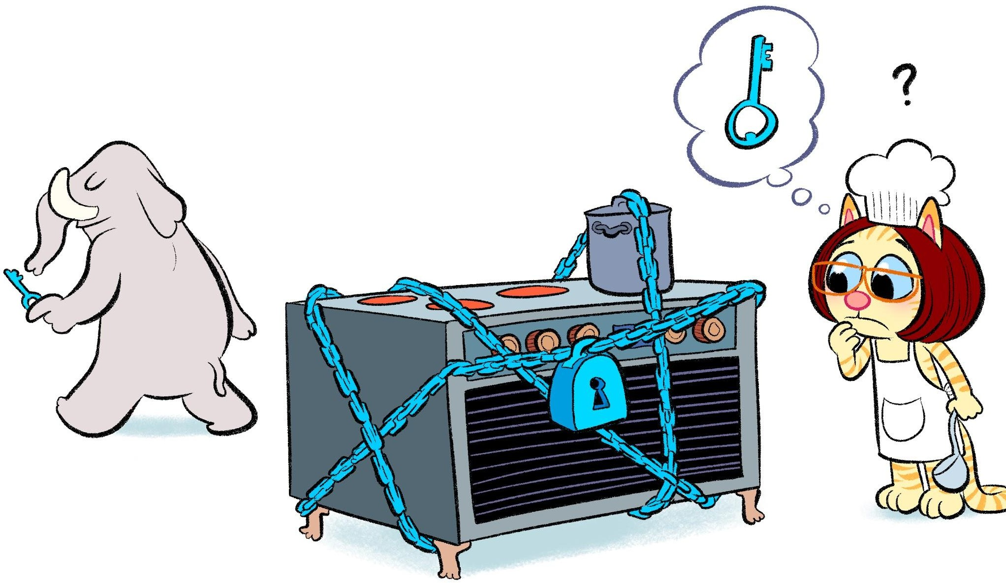
Spend time in the real world
empathy
security is unimportant most of the time
the best security is just there supporting people, it is not extra work for them

Slide 13


Slide 14

Break and fix
just breaking things is not sufficient
fixing things is much harder
you get exposed to the world of compromise
wanting to burn everything down is a fine thing, but it's not going to happen 🔥

Slide 15
Meet the team
security is not just an engineering job
get to meet your legal team
and your PR team
and sell security to the business
and compromise
work with product team

Slide 16
Demand for security people

Slide 17
Hard to hire people
Estimated that there will be 3.5 million unfilled security jobs in 2021
Like every statistic about jobs this is not entirely meaningful, but there is definitely a shortage

Slide 18
You don't need
formal qualifications in security
to have hacked high profile sites
to be a great developer

Slide 19
What is cloud native security?

Slide 20
Everything is code...
before cloud we had security in hardware
firewalls
physical cables
data diode
now everything can be reconfigured in code
this changes everything...

Slide 21
Implications
cannot separate security from development or operations DevSecOps
everything changes much faster
new places to attack, eg supply chain
dev and ops must get involved

Slide 22
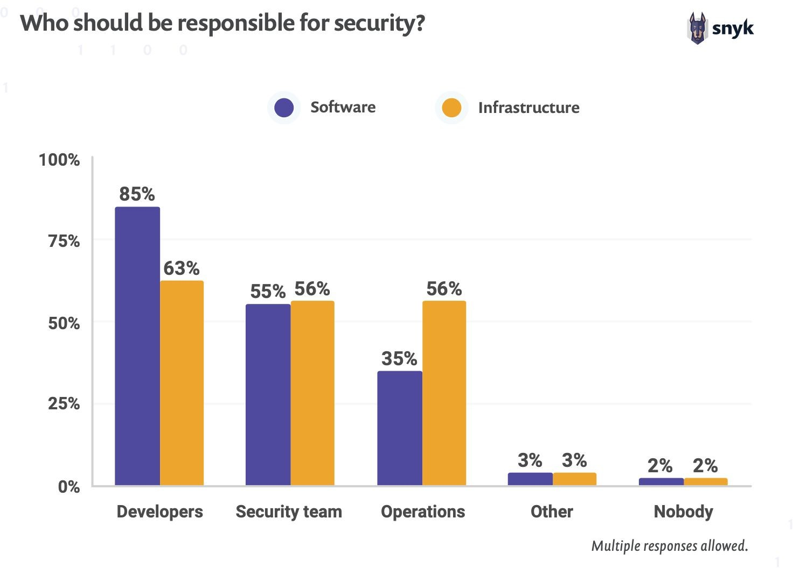
DevSecOps

Slide 23
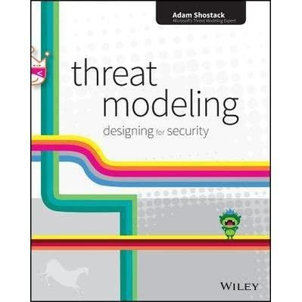
Security in your code
understand the threat model
security is quality
handle errors and the unexpected
understand the issues in domain
write security tests
think like an attacker
spend time attacking
learn from external audits

Slide 24
Burnout

Slide 25

Burnout in security roles
you cannot tell anyone about what you do a lot of the time
not enough people, so often overworked
live away from the happy path

Slide 26

@justincormack

Slide 28
Title
Text

Slide 29
Getting into security by mistake

Slide 30
Getting into security by mistake

Slide 31
Getting into security by mistake

